Slide 1

DEPARTMENT OF INFORMATION TECHNOLOGY
Project name : Smart Parking
Team name : Proj_224789_Team_4
Team members :
Mohamed Nayeemullah S (113321205030)
Thariq Hameed A (113321205052)
Mohamed Sheik Noor A (113321205031)
Adhithyan K S (113321205002)

Slide 2

Project Definition:
The Smart Parking aims to develop a sophisticated parking management system that leverages Internet of Things (IoT) technologies to improve the efficiency, convenience, and sustainability of parking facilities. This system will address the common challenges associated with finding and managing parking spaces in urban areas and busy locations.

Slide 3
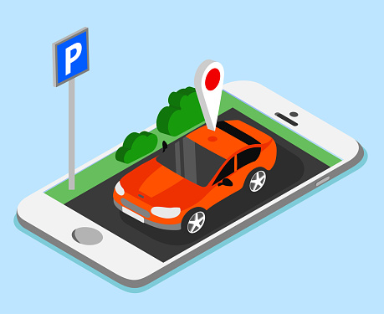
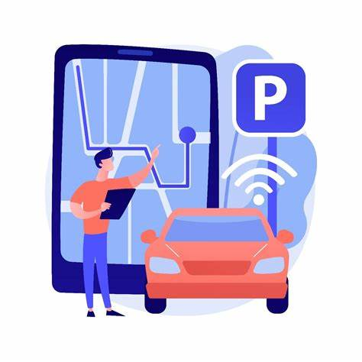
Objectives:
1. Parking Space Detection
2. Real-time Status Display
3. Sensor Integration
4. Environmental Sustainability
5. Scalability and Adaptability
6. User-Friendly Mobile App
7. User Notification
8. Reduced Traffic Congestion
9. Safe Parking

Slide 4
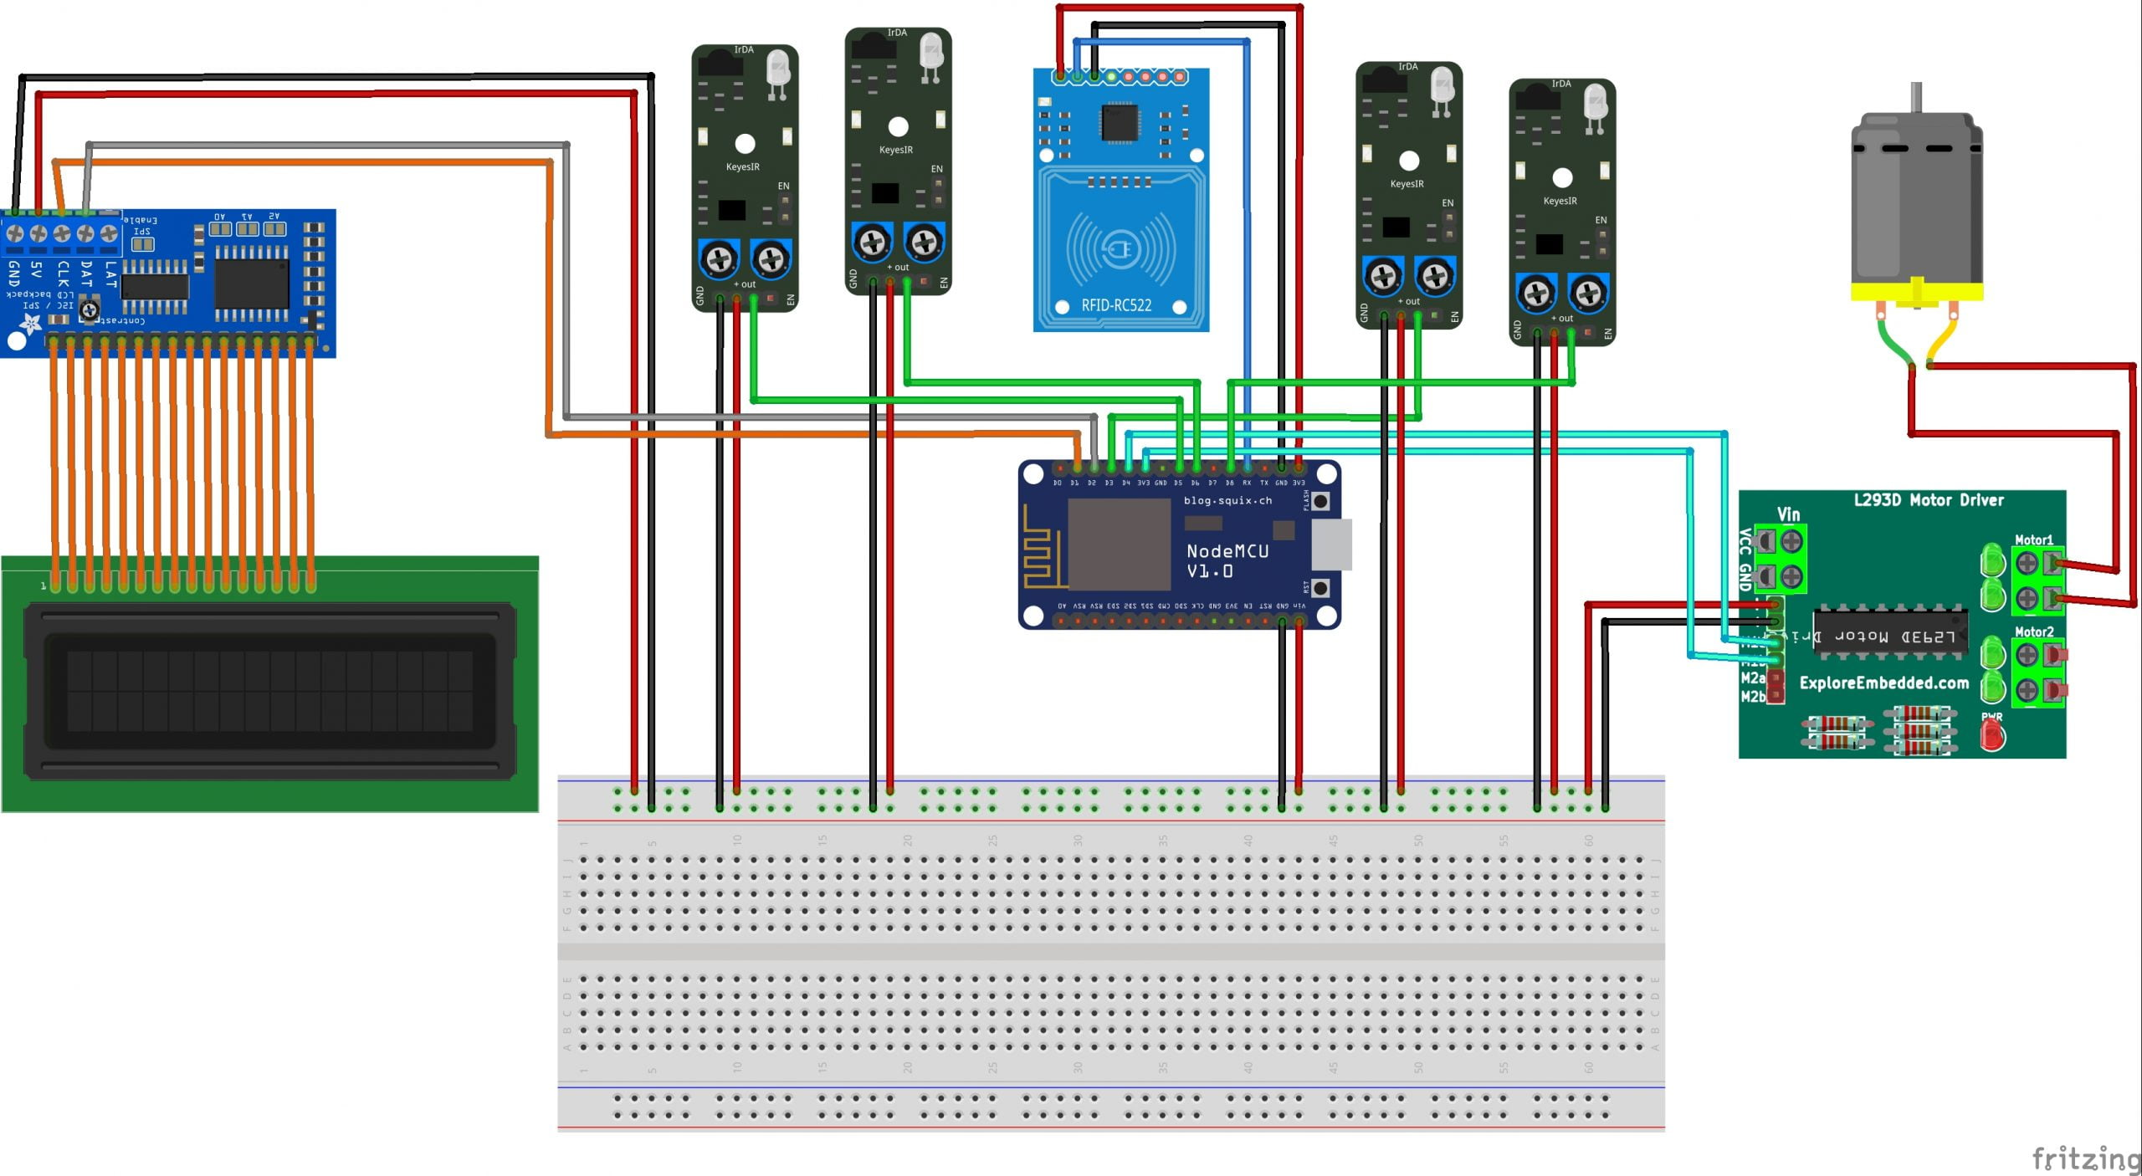
IoT Sensor Design:
A Smart Parking system relies on various sensors and components to detect the presence or absence of vehicles, collect data, and transmit information to a central server or user interface. Here are some of the common sensors and components used:
1. Ultrasonic Sensors
2. Infrared (IR) Sensors
3. Microcontrollers
4. Communication Modules
5. LED Indicators
6. Buzzer
7. LCD Display
8. Power Supply
9. Mobile App

Slide 5
Real-Time Transit Information Platform:
Sensor Integration:
Begin by integrating parking space sensors (e.g., ultrasonic, infrared) into each parking spot. Connect the sensors to a microcontroller (e.g., Arduino) for data collection.
Public Transit Data Integration:
Access real-time data from public transit agencies, including bus and train schedules, current locations, and estimated arrival times.
Real-Time Updates:
Continuously update the platform with real-time data, including parking space availability, bus and train locations, and estimated arrival times.

Slide 6
Real-Time Transit Information Platform:
User-Friendly Interface:
Develop a user-friendly mobile or web application that combines parking and transit information. Users can access this platform on their smartphones or computers.
User Alerts:
Send push notifications or alerts to users about parking space availability, transit delays, or relevant updates based on their preferences and location.
User Feedback and Reporting:
Include a feature for users to report issues, provide feedback, or request assistance related to parking.

Slide 7
Integration Approach:
Sensor Integration:
Begin by integrating parking space sensors (e.g., ultrasonic, infrared) into each parking spot. Connect the sensors to a microcontroller (e.g., Arduino) for data collection.
Data Collection and Processing:
Program the microcontroller to collect data from the sensors and process it to determine parking space occupancy status (vacant or occupied).
Connectivity:
Ensure reliable connectivity for the microcontroller. Depending on the deployment location, use Wi-Fi, cellular networks, LoRa, or other suitable communication methods to transmit data to a central server.

Slide 8
Integration Approach:
Centralized Server:
Set up a central server that collects and stores data from all parking sensors. This server serves as the backbone of the system.
Database Management:
Implement a database to store historical parking data, including timestamps, occupancy status changes, and any user-related data (e.g., reservations and payments).
User Interface:
Develop a user-friendly mobile or web application to provide real-time parking information to users. The application should allow users to check parking availability, make reservations, and provide feedback.
Real-Time Updates:
Implement a mechanism for real-time data updates within the application. Users should see immediate changes in parking availability as spaces are occupied or vacated.

Slide 9
Integration Approach:
User Alerts:
Implement a notification system to alert users about parking availability.
Deployment:
Deploy the Smart Parking IoT system in the target locations, ensuring proper sensor calibration and system readiness.

Slide 10
THANK YOU

